Slide 1


Cloud Native Data Architecture

Slide 2
Data Flow Diagram_Cloud Native Data Architecture
AWS GLUE
AWS REDSHIFT
AWS SAGEMAKER
1. AMAZON S3 BUCKETS / DATA LAKE
1. MSBA Analyst A:
msba_fg_ratios.csv.
3. MSBA Analyst B:
msba_fg_bankruptcy.csv
2. DATACORP:
datacorp_financials.csv.
company_profiles_to_predict_unlabeled.csv
- Perform our Extract, Transform and Load process.
- Make future data ingestion easy to replicate or automate.
- Joining ratios and financials data to a single table.
“Single source of truth”
- Data Warehouse
1.Create a Redshift Cluster: msba-fingroup-cluster
2. Use Query Editor to:
- Create New tables to place data we transformed.
- Create a Model using AWS Canvas.
- Review model performance, insights, analyze metrics.
- Predict probability of bankruptcy for new set of companies.

Slide 3

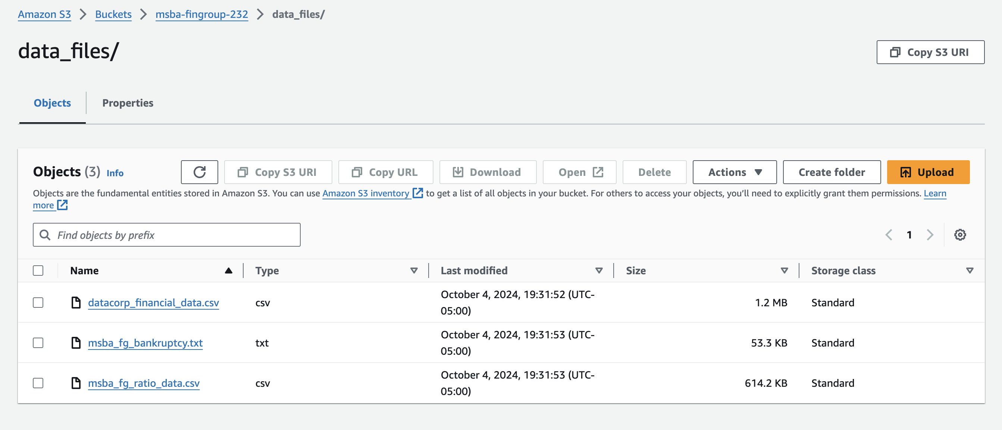
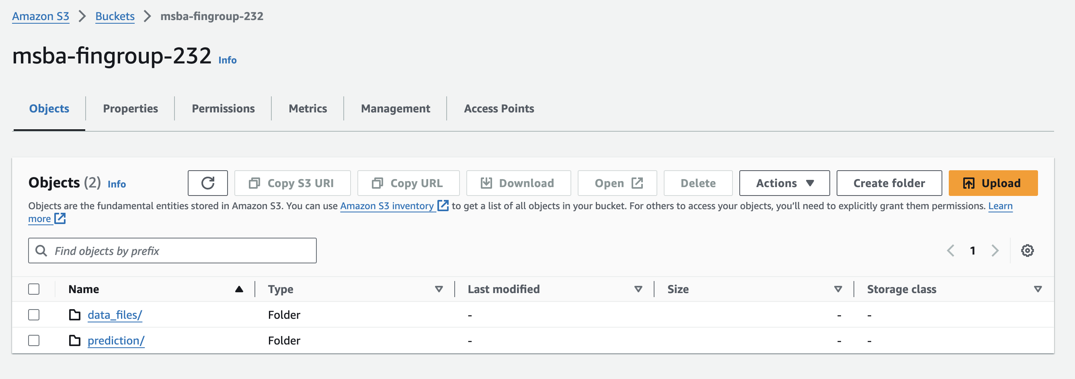
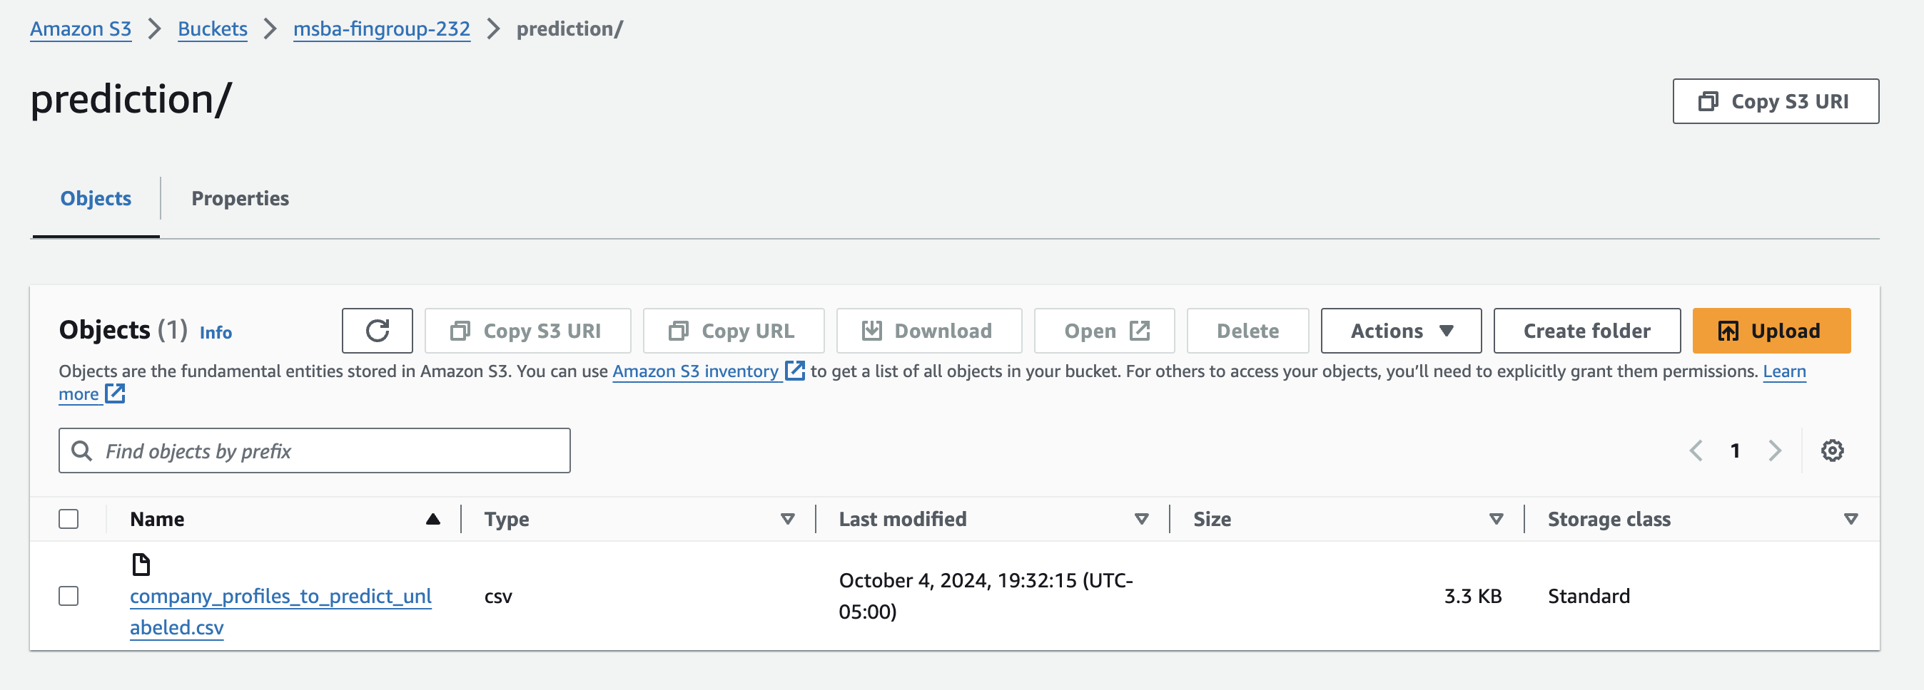
Data Lake: S3-Bucket
Our data lake is the landing place for all our data, we can store all types of files, securely. Buckets allow to store data for various data types, sizes, and sources.

Slide 4

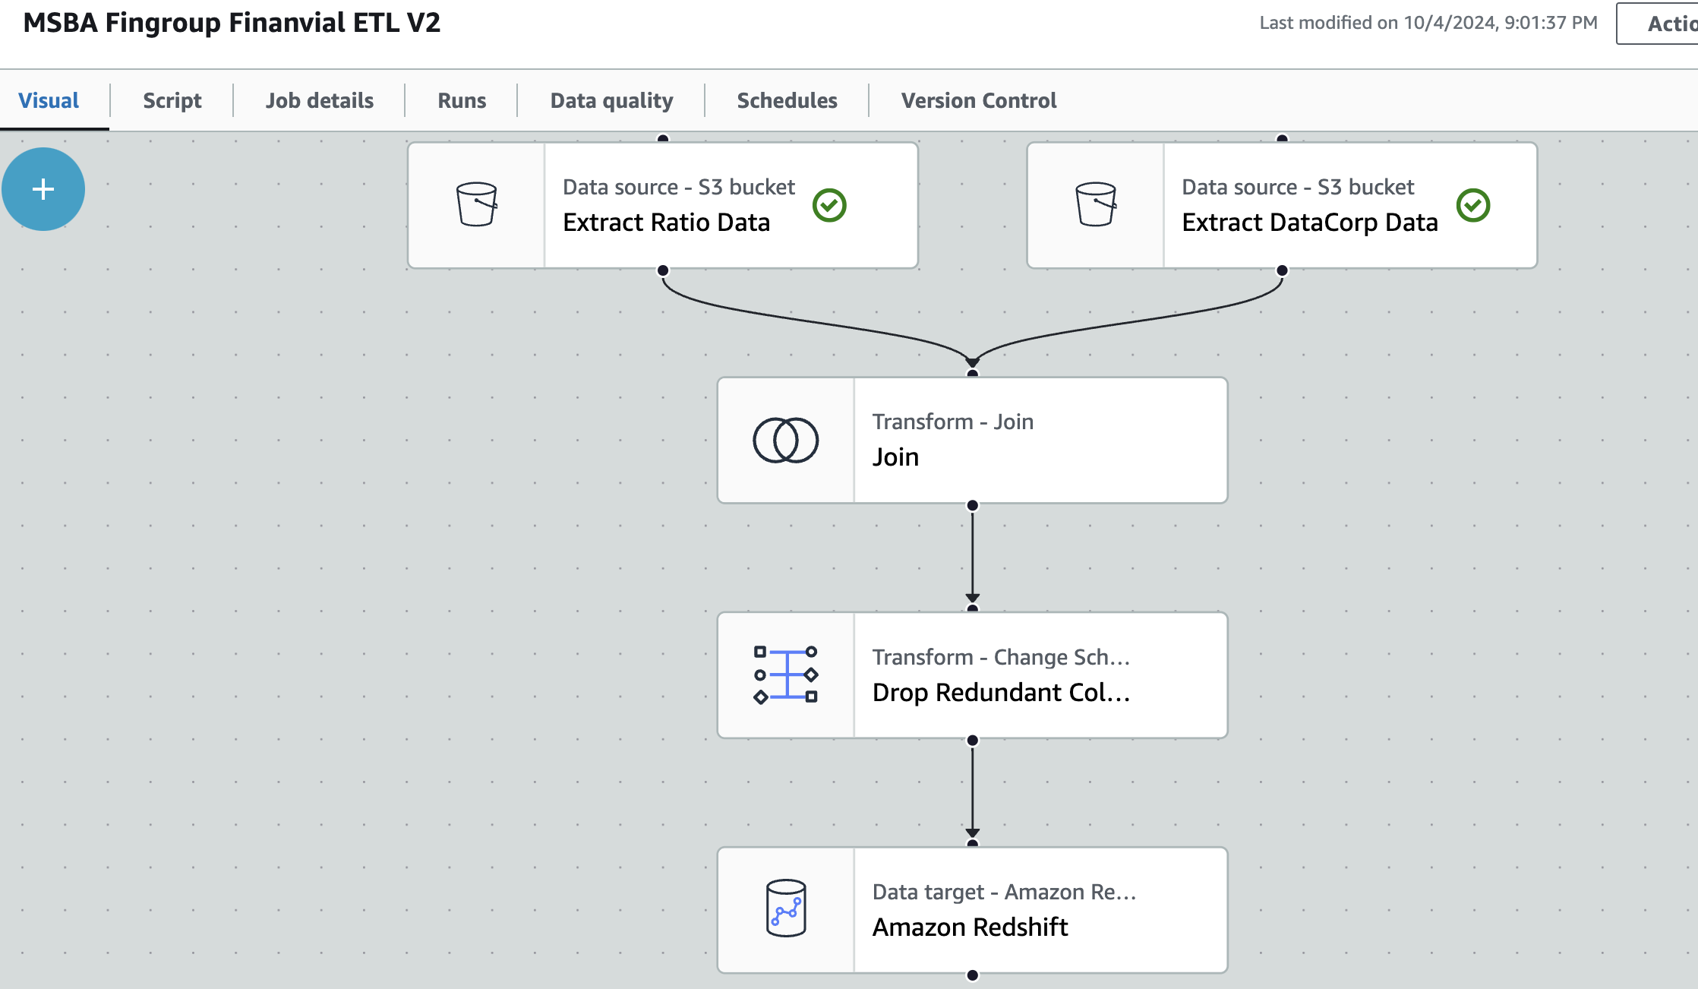
AWS GLUE
This tool allows us to integrate data.
For this prototype we want to join data from the files: “msba_fg_ratios.csv” and the “datacorp_financials.csv”
After joining the tables we will drop redundant columns.
We will load the final table to our data warehouse, into the table called “financials_combined”.

Slide 5
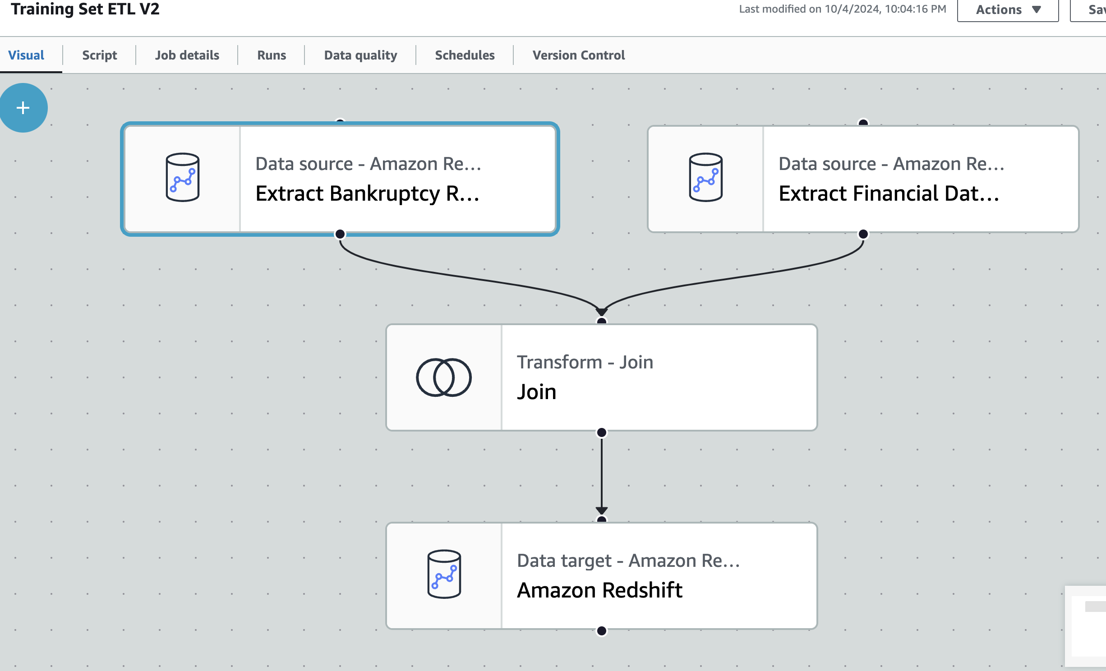
AWS – Glue - Training Set ETL
The second joining will be, joining our Bankruptcy table with the financials combined table.
After performing a left join, we will load the information to our data warehouse, more specifically to a table called training_set.

Slide 6

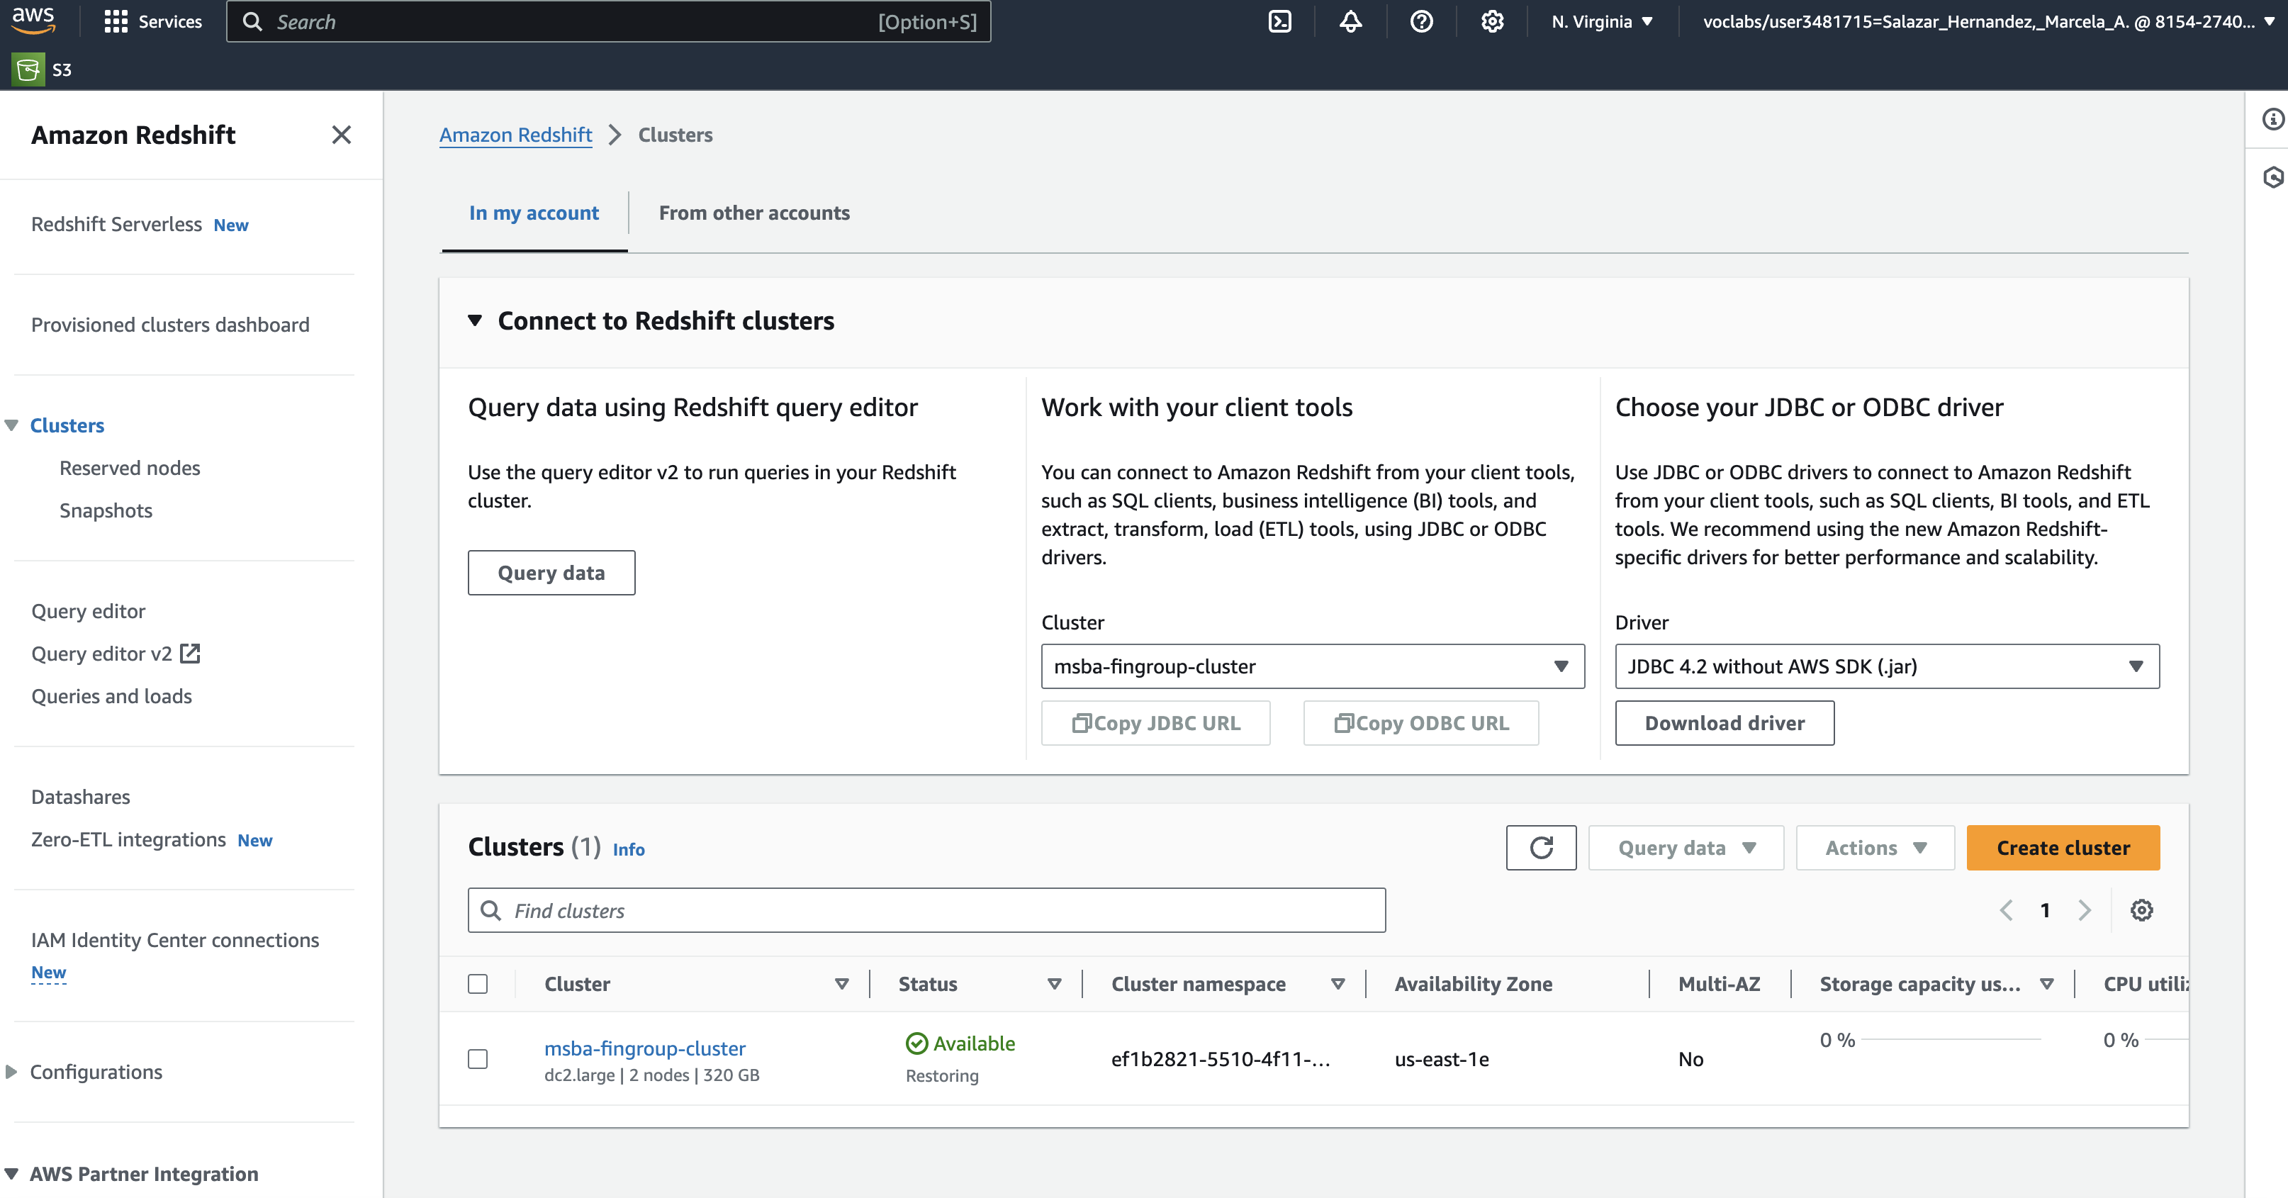
Redshift / Data Warehouse
“Single source of Truth”
Redshift / Data Warehouse is a central repository of integrated data.
Pros:
Provides a consistent view of an organization.
Integrated view for value added reporting.
DW in the Cloud benefits: affordable, scalable and availability.
Can connect to AWS Sagemaker to build, tune and train models.
Cluster creation.
Cluster: computing nodes, used to run a data warehouse. Clusters can be scaled up and can run complex queries.
Cluster name: msba-fingroup-cluster

Slide 7
Redshift – Query Editor
The Query Editor tool in Redshift allows us to run SQL queries.
We will create three tables in our data warehouse:
Table 1: “financials_combined”
Table 2: “bankruptcy”
Table 3: “training_set”
Load data:
Into “bankruptcy” table.

Slide 8
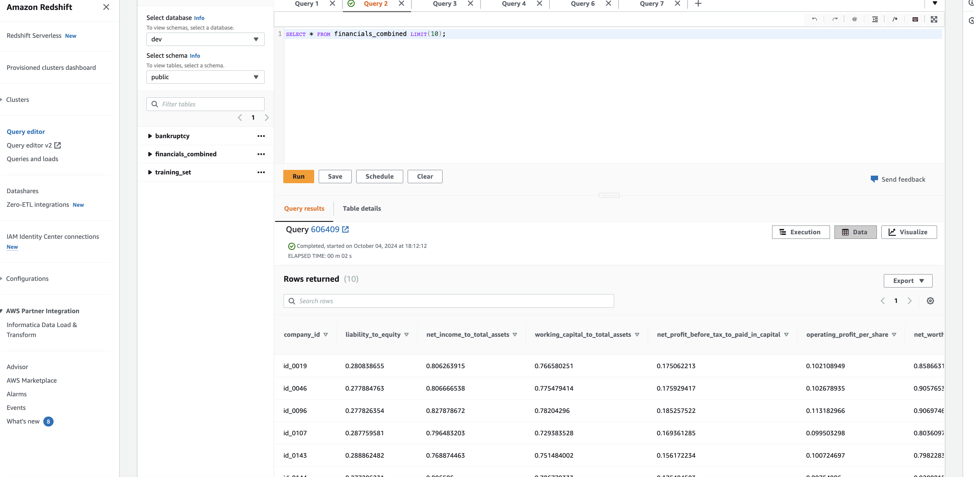
Review / Financials Combined

Slide 9

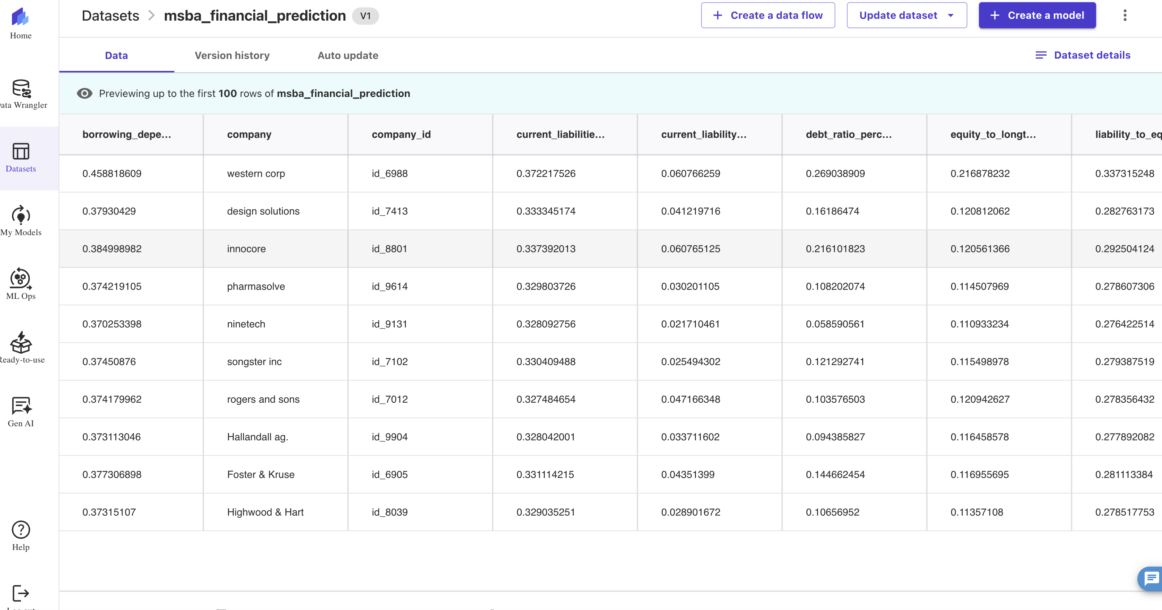
Canva: Model Building
Using our training_set data we will build our model.
Sagemaker, will try different models, until it finds the model that will make the best predictions.

Slide 10
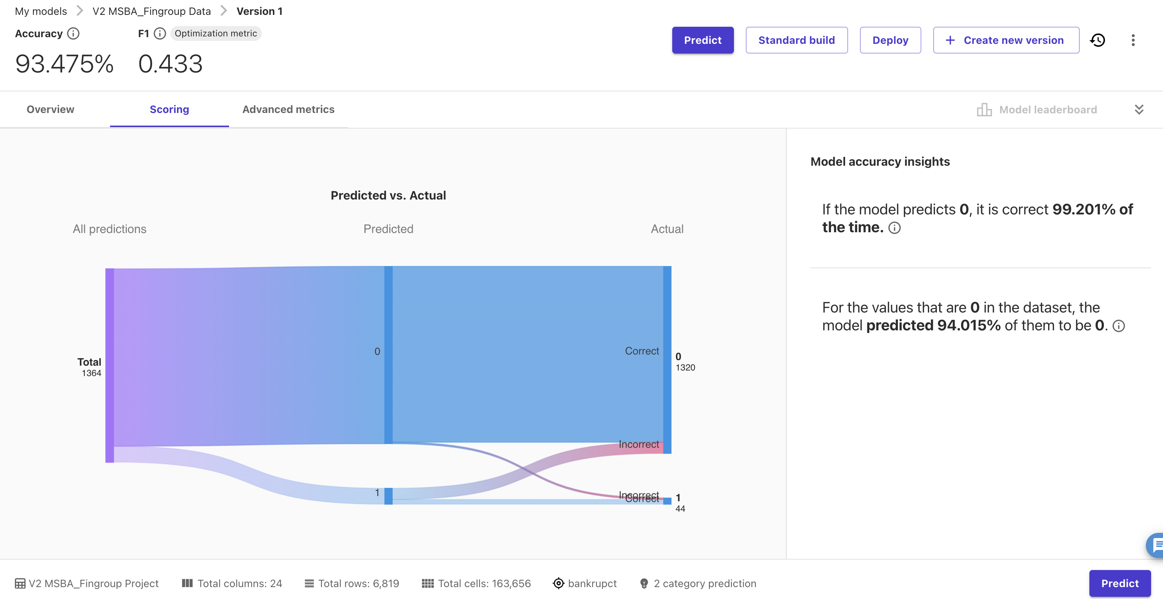
Canvas: Model Building
The model gives us an accuracy of 93.475%.
The data set is unbalanced, that means that it has more non-bankruptcies that bankruptcies. It is a good idea to review other metrics, like AUC-Roc.
The AUC-ROC shows a 0.922 which means the model can differentiate between the two classes.

Slide 11
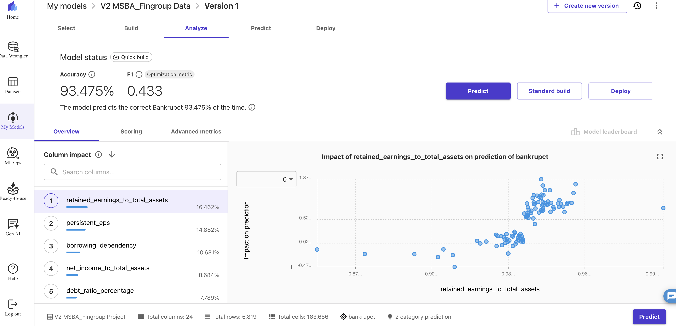
Analysis
Sagemaker, shows us which features have the highest impact on the model’s ability to predict bankruptcy.

Slide 12
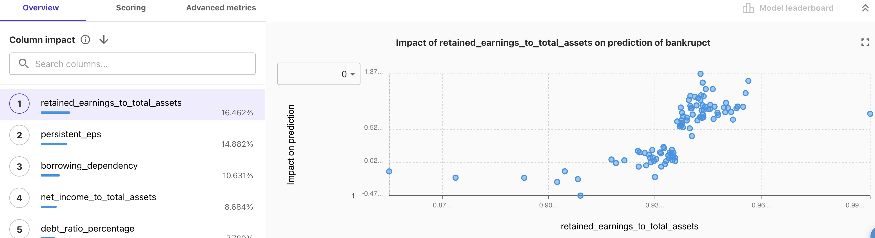
Analysis
Three most impactful features:
Retained Earnings to Total Assets
This financial metric has a 16.46% impact on our model’s ability to predict bankruptcy.
It is a very important financial indicator, because it shows:
Company’s Long Term Profitability.
Ability of a Company to Internally Finance Operations (makes the company less dependable on external funding).
Stability.
Company re-investment.

Slide 13
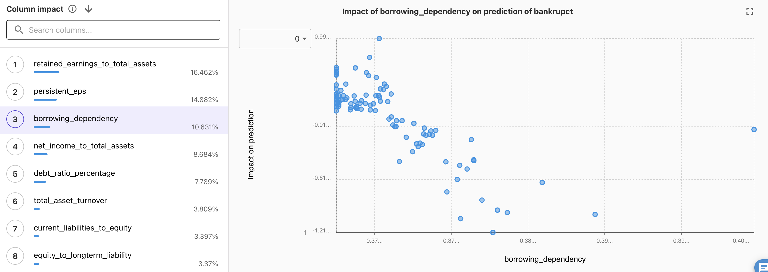
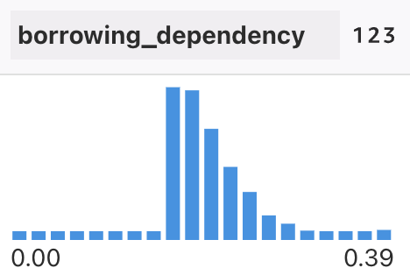
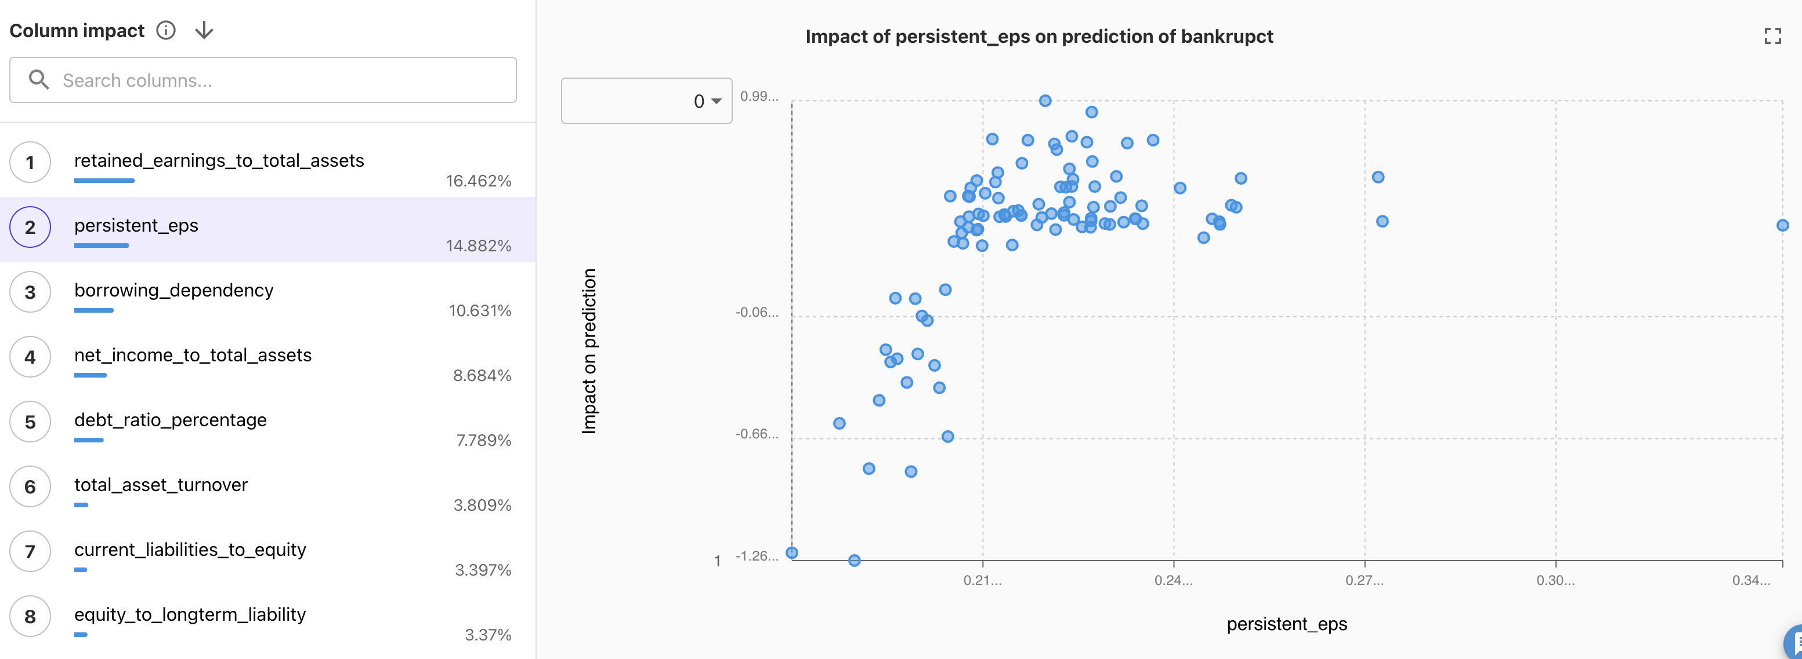
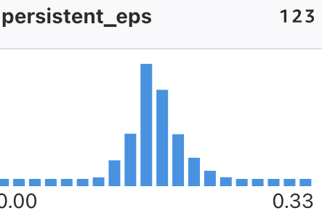
Analysis
Three most impactful features:

Slide 14
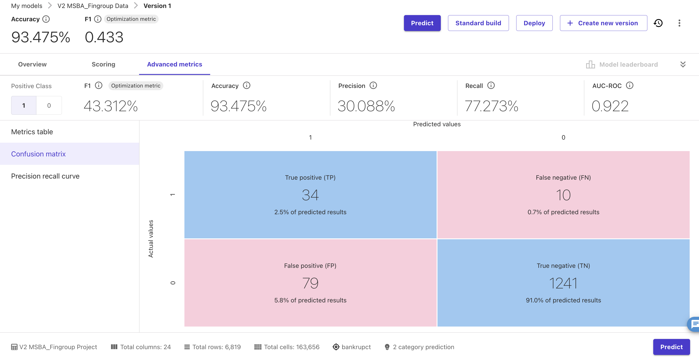
Analysis / Confusion Matrix
There were 79 false positives, which means that the model predicted 79 companies going bankrupt that did not.
Also, the model shows 10 false negatives, that means that the model wrongly predicted 10 companies that went bankrupt.
Our recall metric is at 77.273%, that indicated the model is doing a good job at identifying companies going bankrupt.
*This must be analyzed, as the cost of predicting a company going bankrupt and not occurring (missed opportunity cost) in my opinion is less than investing in a company and having it go bankrupt. False positives might be less damaging than false negatives, as we want to avoid high-risk investments.

Slide 15
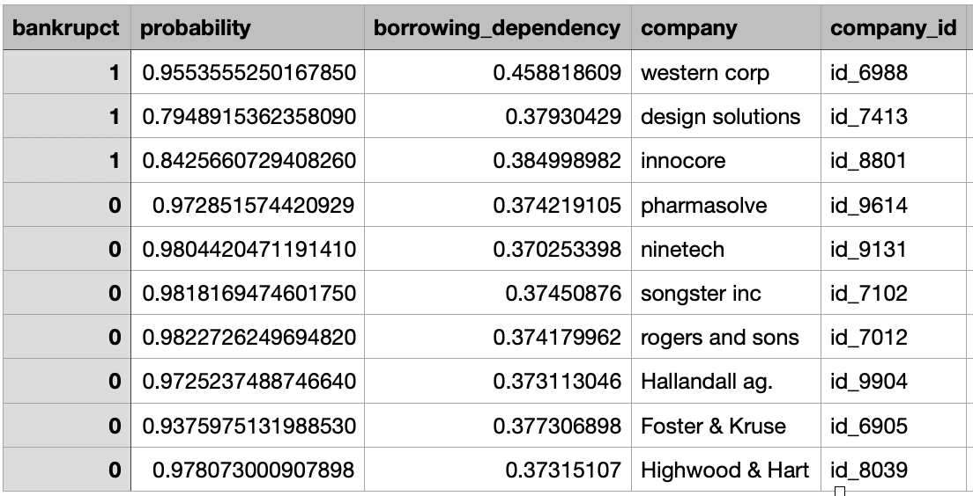
Predictions
Utilizing the model built, we will not predict the probability of bankruptcy for a new set of companies the MSBA is looking to invest in.
Based on the results is not recommended for MSBA to invest in Western Corp, Design Solutions and Innocore.

Slide 16
Recommendation
Based on our model’s prediction it is recommended to invest in:
Rogers & Sons
Songster Inc.
Pharmasolve
bankrupct | probability | borrowing_dependency | company | company_id | persistent_eps | retained_earnings_to_total_assets
0 | 0.9822726249694824 | 0.374179962 | rogers and sons | id_7012 | 0.21896568 | 0.942828956
0 | 0.9818169474601746 | 0.37450876 | songster inc | id_7102 | 0.217831143 | 0.938289897
0 | 0.972851574 | 0.374219105 | pharmasolve | id_9614 | 0.225205635 | 0.935449309
0 | 0.9804420471191406 | 0.370253398 | ninetech | id_9131 | 0.218398412 | 0.935200209
0 | 0.9725237488746643 | 0.373113046 | Hallandall ag. | id_9904 | 0.20468942 | 0.932955215
0 | 0.978073001 | 0.37315107 | Highwood & Hart | id_8039 | 0.212914815 | 0.930763203
0 | 0.9375975131988525 | 0.377306898 | Foster & Kruse | id_6905 | 0.219343859 | 0.930139635

